Slide 1
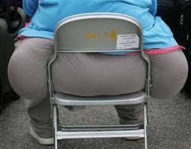
Obesity
Madalyn Montgomery

Slide 2
Report Factors that may or may not cause obesity
Food
- unhealthy, or too much
- School lunches
* healthier school lunches
* children are not getting full

Slide 3
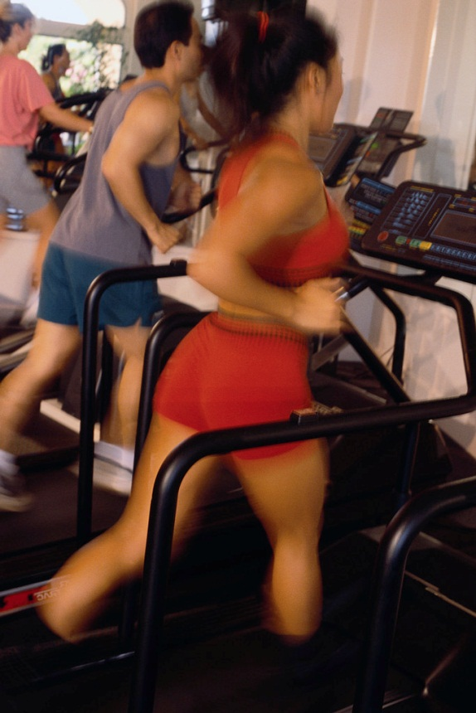
Report Factors that may or may not cause obesity
Exercise
-laziness
-gym class
make more gym time
own choices, should it be
required?

Slide 4
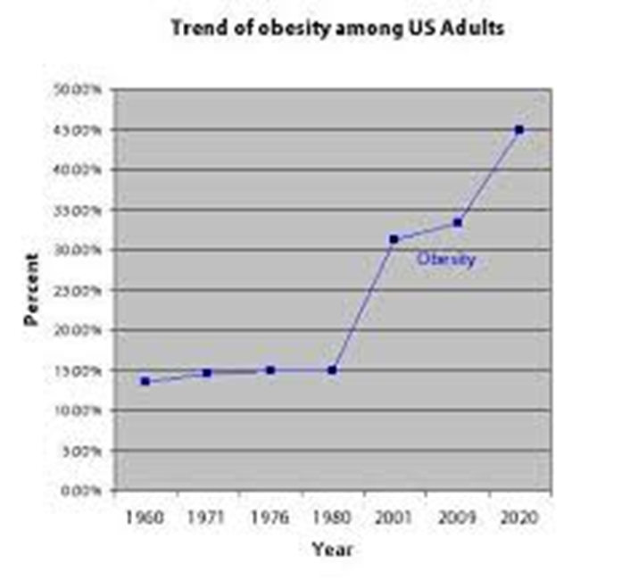
Report Factors that may or may not cause obesity
Technology
- Sedentary lifestyle
- Advertisement
*think it is linked to obesity
-businesses target children
*think it’s not linked to obesity
-increase in obesity rate in all ages not just kids

Slide 5
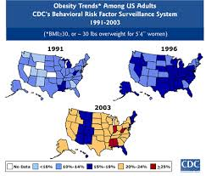
Position
children in their teens are getting Type II Diabetes
The number one reason patients are in hospital is because heart diseases, and circulation disease
food, technology and laziness to blame for epidemic

Slide 6
Proposal
Daily actions that help
Focus on fast food restaurants
-Leaner meats
-Smaller portions
-No 24 hour
take small steps to decrease the obesity epidemic

Slide 7
Final Portfolio Profile and Blog
Susanne Eman
http://www.youtube.com/watch?v=43D3Q9bluM8&feature=related
I used her to discuss how out of control obesity can get and hope to put a stop on it before we get as out of control as Susanne is

