Slide 1
Conserve
Waterwise Landscaping

Slide 2
Waterwise Options
Zeroscaping
Xeriscaping

Slide 3
Purpose of Landscaping
Beauty
Utility
Conservation
Notes:
With water becoming a limited resource, conservation has become a third purpose for landscaping.

Slide 4
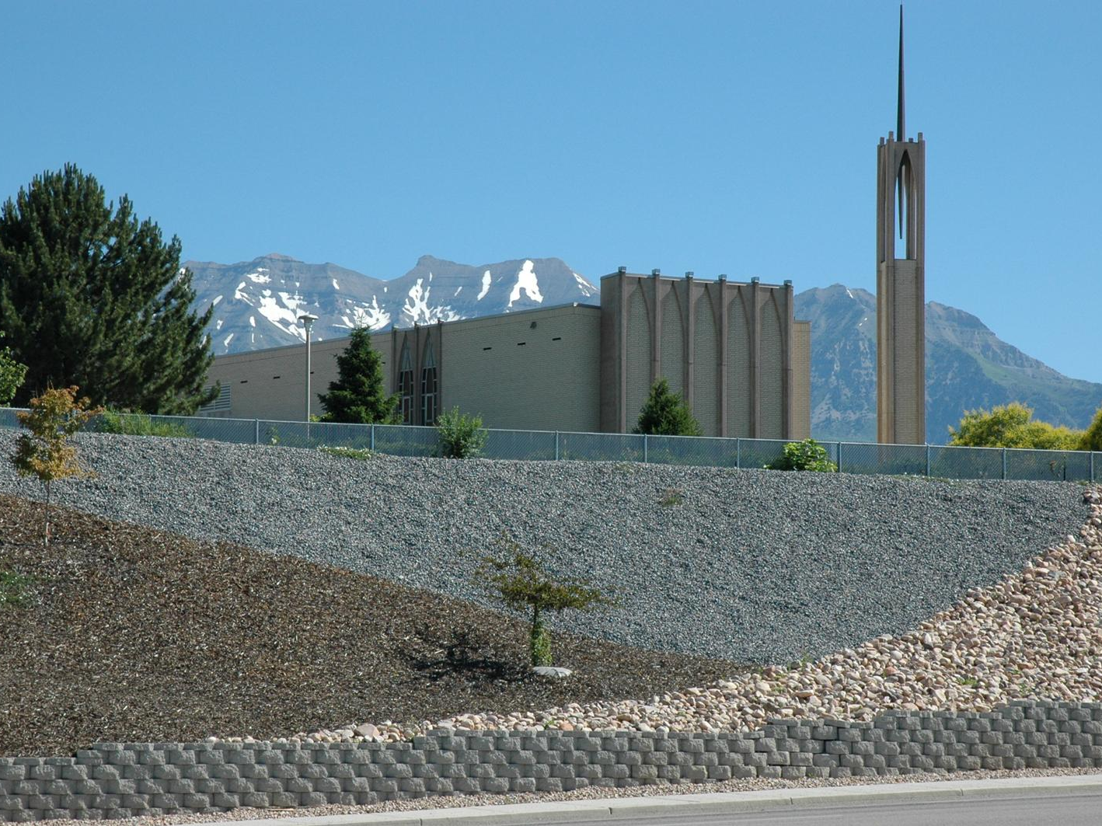
Zeroscaping
Low to No Maintenance Landscaping Design
Characteristics
Uses a variety of rocks for design
Sparse use of drought resistant plants
Relies on rainwater or limited watering

Slide 5
Characteristics
Uses a variety of rocks for design
Sparse use of drought resistant plants
Relies on rainwater or limited watering

Slide 6
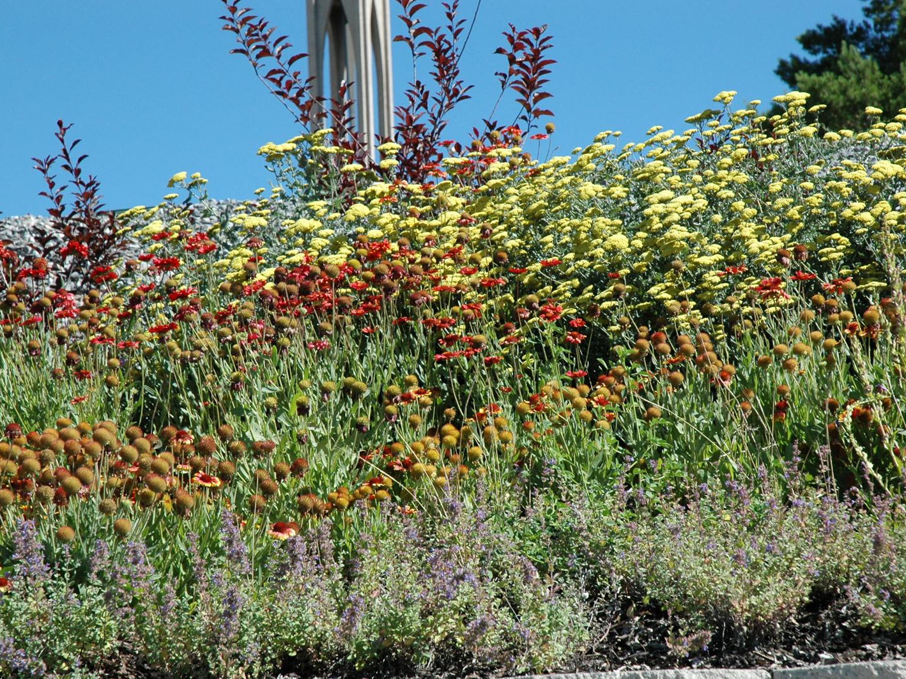
Xeriscaping
Water –Conservative
Approach to Landscaping
Notes:
Xeriscaping is created by the combination of the Greek word Xeros (dry) with landscaping. Term coined by the Front Range Xeriscape Task Force of the Denver Water Department in 1981.

