Slide 1
Conserve
Waterwise Landscaping

Slide 2
Purpose of Landscaping
Beauty
Utility
Conservation
Notes:
With water becoming a limited resource, conservation has become a third purpose of landscaping.

Slide 3
Waterwise Options
Zeroscaping
Xeriscaping
Wildfire Aware Options
Defensible landscaping
Zoning

Slide 4
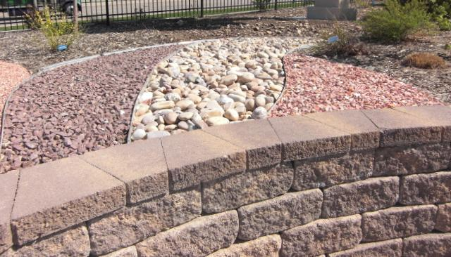
Zeroscaping
Low to No Maintenance Landscaping Design

Slide 5
Characteristics
Uses a variety of rocks for design
Sparse use of drought resistant plants
Relies on rainwater or limited watering

Slide 6
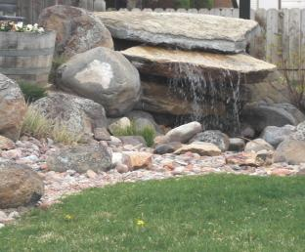
Xeriscaping
Water –Conservative Approach to Landscaping
Notes:
Xeriscaping is created by the combination of the Greek word Xeros (dry) with landscaping. Term coined by the Front Range Xeriscape Task Force of the Denver Water Department in 1981.

Slide 7
Characteristics
Uses a variety of rocks for design
Sparse use of drought resistant plants
Relies on rainwater or limited watering

Slide 8
“Fire Aware” Landscaping
10’
10’
30’
Zone 1
Zone 2
Zone 3
Notes:
Wildfire is a common threat and natural occurrence. Maintaining an appropriate defensible space around your home is essential. Zone 1: Clear trees within 30 feet of your home and create hardscaped surfaces such as patios and walkways to create a fire resistant buffer. Avoid wooden decks and stacking firewood close to your home. Zone 2: Thin shrubs and trees in the 10-foot wide zone. Remaining trees should be pruned to 10 feet above ground. Zone 3: Keep grasses mown low between trees for at least 10 feet.

Slide 9
Principles for Waterwise Landscaping
Tips from the Office of Community Services, Fort Lewis College
Develop Landscape Plan
Condition Your Soil
Limit Lawn Size
Irrigate Efficiently

